Slide 1

Git Version Control System
by
Chaithra TV
Vidyalaxmi Shenoy
Vijayalakshmi Kamath
03-Jan-14

Slide 2

Contents
Introduction
Git as DVCS
The Three States
File Status Life Cycle
Fork and Clone
Commit
Branching
Merging
Collaborator
Push, Pull and Sync

Slide 3
Introduction
Git is a distributed version control system and source code management system with emphasis on speed.
Every git working directory is a full fledged repository with complete history and full version tracking capabilities, not dependent on network access or central server.
Git supports rapid branching and merging, and includes specific tools for visualizing and navigating a non linear development history.

Slide 4
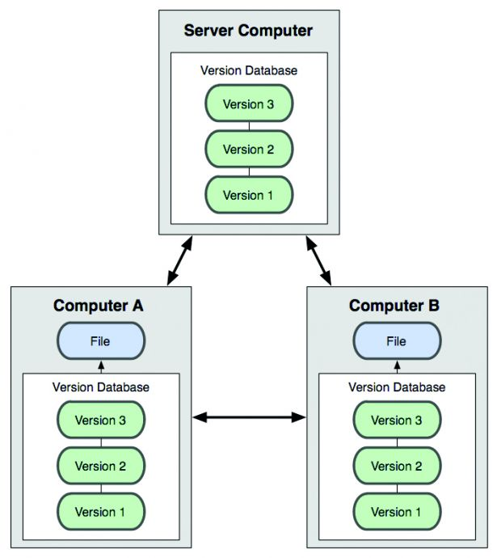
Git as DVCS
Client fully mirror the repository instead of just checking out the latest snapshot of files.
Fig. 1: Distributed Version Control Diagram

Slide 5

The Three States
Committed
Modified
Staged
Fig. 2: Working directory, staging area, git directory

Slide 6
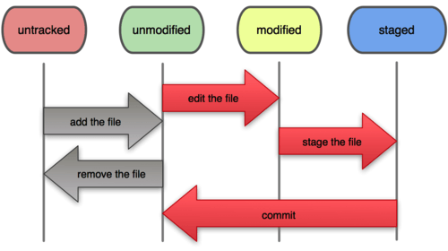
File Status Life Cycle
Fig. 3: The life cycle of the status of the files

Slide 7

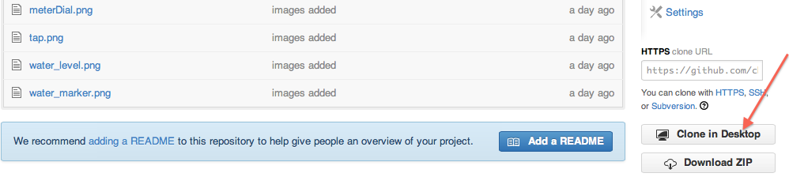
Fork and Clone
Fork: Creates a copy that can be modified independently.
Fig. 4: Forking a repository
Clone: Creates a local copy of the source code from the source control.
Fig. 5: Cloning a repository

Slide 8
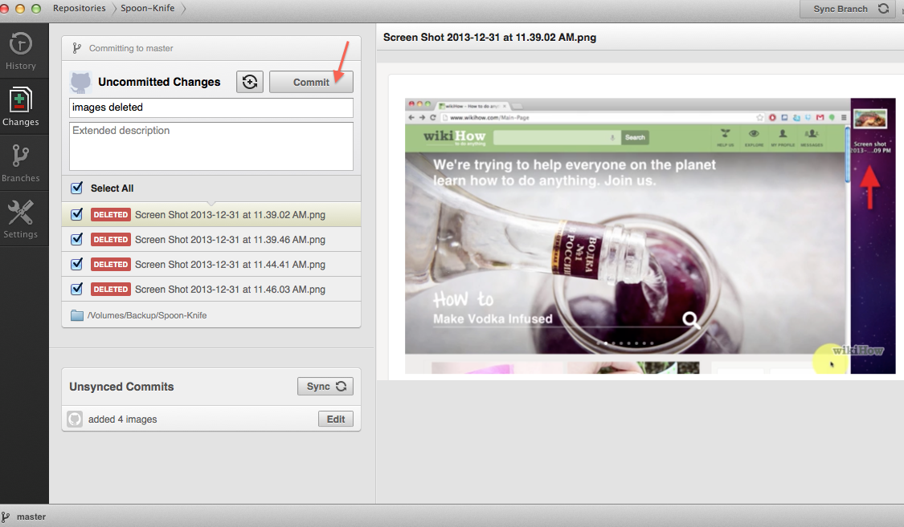
Commit
Safely stores data in local repository.
Fig. 6: Committing changes

Slide 9
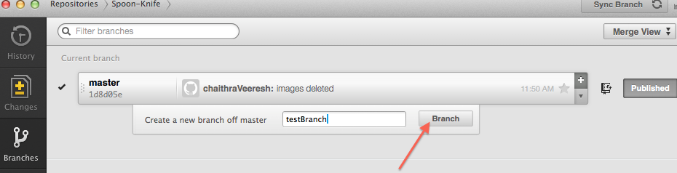
Branching
Branch: Creates isolated development environment within a single repository
Fig. 7: Creating new branch

Slide 10
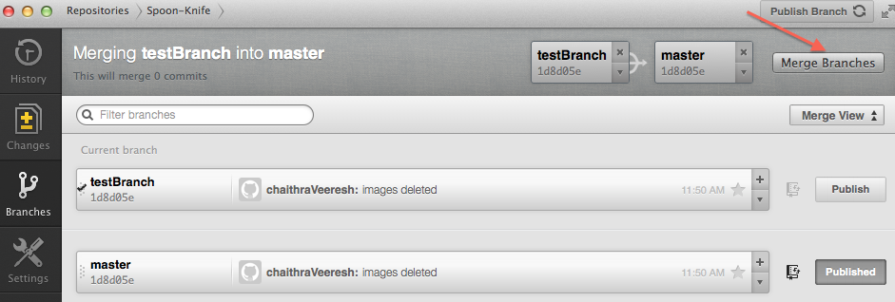
Merging
Merge: Integrates changes from divergent branches.
Fig. 8: Merging two branches

Slide 11
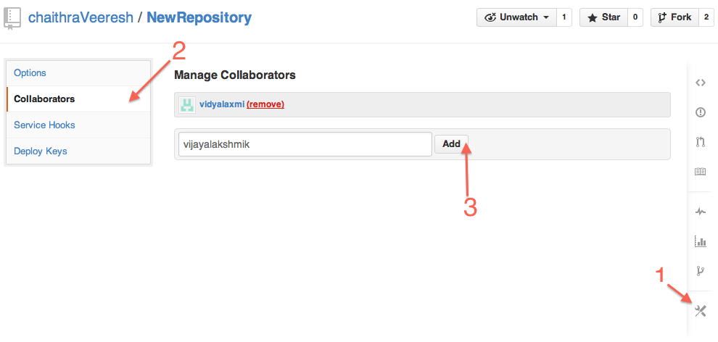
Collaborator
Used to grant access to repository owned by a personal account.
Collaborators always receive read/write permissions.
Fig. 9: Adding collaborators to repository

Slide 12
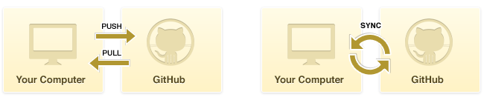
Push, Pull and Sync
Pull: Brings the repository up to date with remote repository.
Push: Updates the changes to remote repository.
Sync: Turns the complex workflow of pulling and pushing into single operation.
Fig. 10: Push pull and sync operation

Slide 13
Thank You
Q & A

